Slide 1
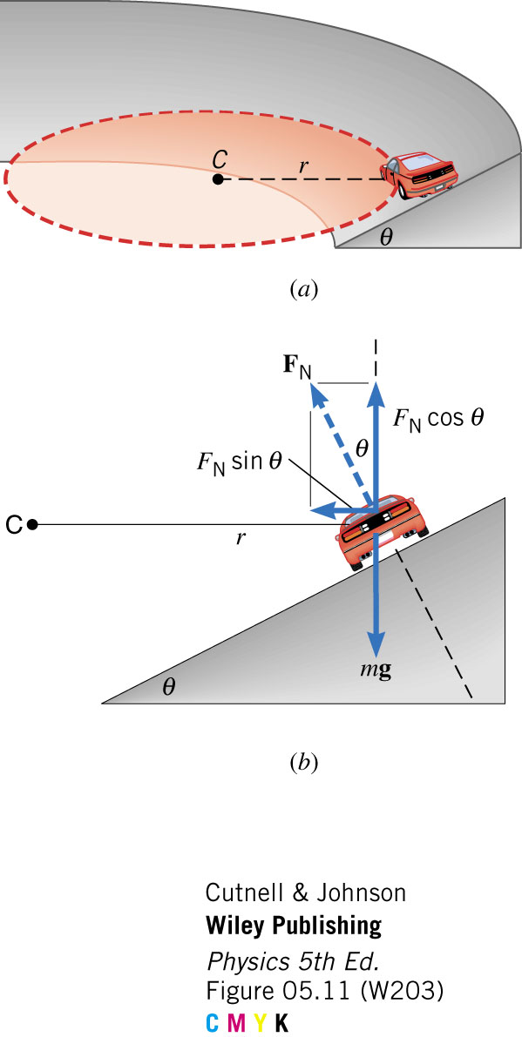
CIRCULAR MOTION
Banked Curves

Slide 2
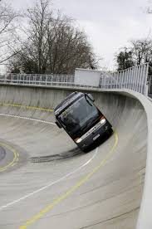
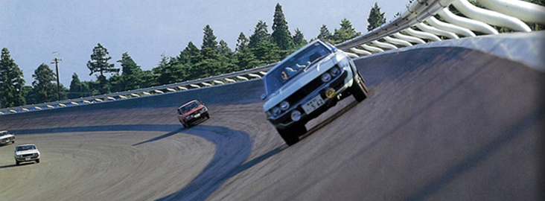
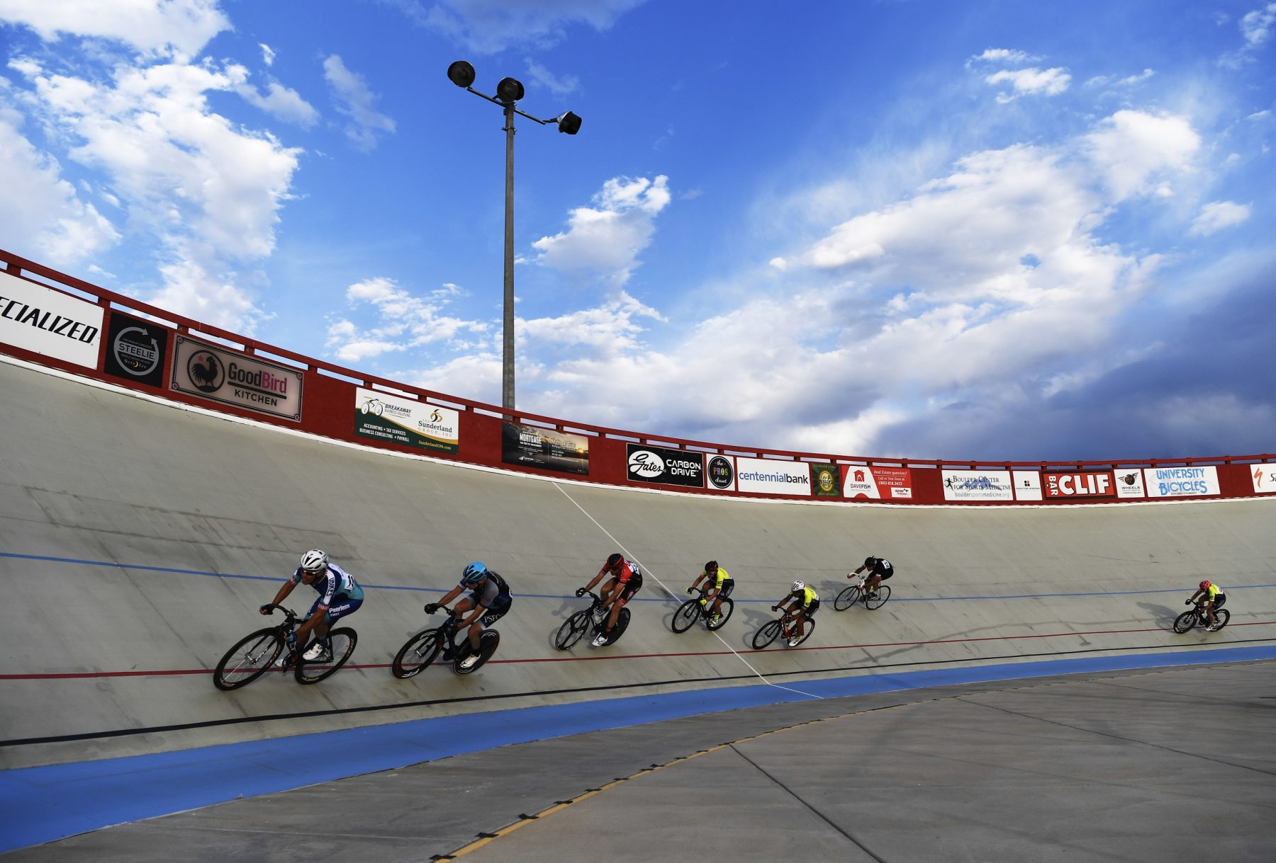
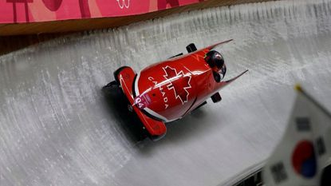
CIRCULAR MOTION
On many road bends, the road is not perfectly flat, but rather at a small angle to the horizontal. This enables vehicles to travel at higher speeds without relying on friction (and therefore, without skidding). Of course, it’s not just conventional vehicles that rely on this principle…

Slide 3

FORCES ON A BANKED TRACK
$$tanθ=\frac{F_{C}}{F_{g}}$$
$F_{C}=\frac{mv^{2}}{r}$ ; $F_{g}=mg$
$$tanθ=\frac{\left(\frac{mv^{2}}{r}\right)}{mg}$$
$$tanθ=\frac{v^{2}}{rg}$$
$$v=\sqrt{rg.tanθ}$$
$$θ=\tan^{−1}{\frac{v^{2}}{rg}}$$
F_{C}
C = Centre of Curvature
r = Radius (m)
F_{N}
F_{N}
F_{g}
θ
F_{C}
θ
F_{g}

Slide 4
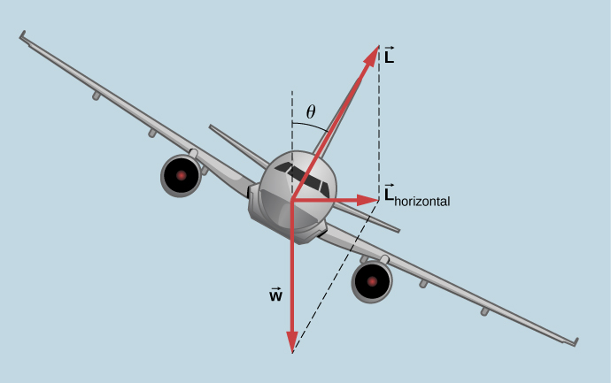

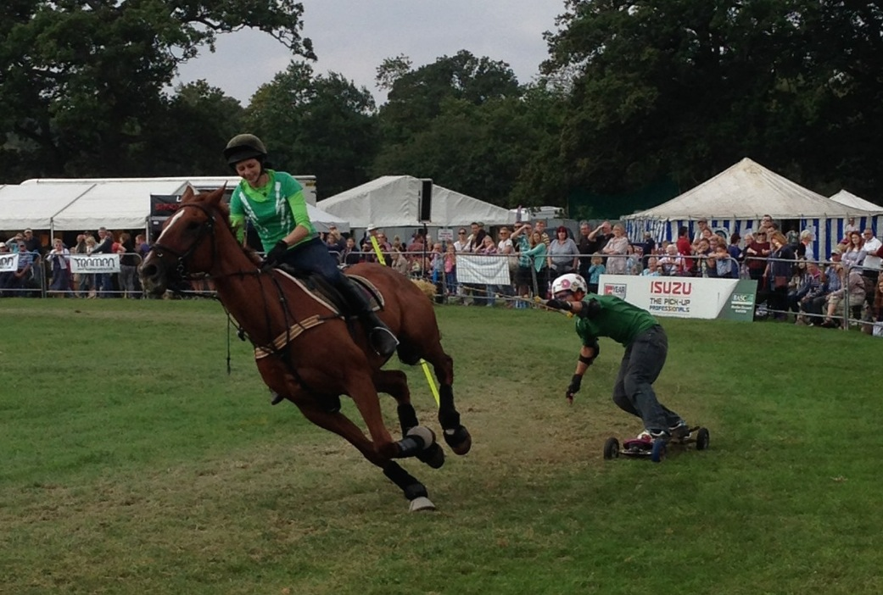
FORCES ON A BANKED TRACK
Note that the centripetal force, in this case, is not provided by a friction force, but by the normal force.
Normal force can be harnessed on horizontal roads too, allowing for faster cornering without slipping.
Other forces, too, can be used to corner effectively (i.e. lift).
In each case, what happens to F_{C} as the angle to the horizontal varies?

Slide 5
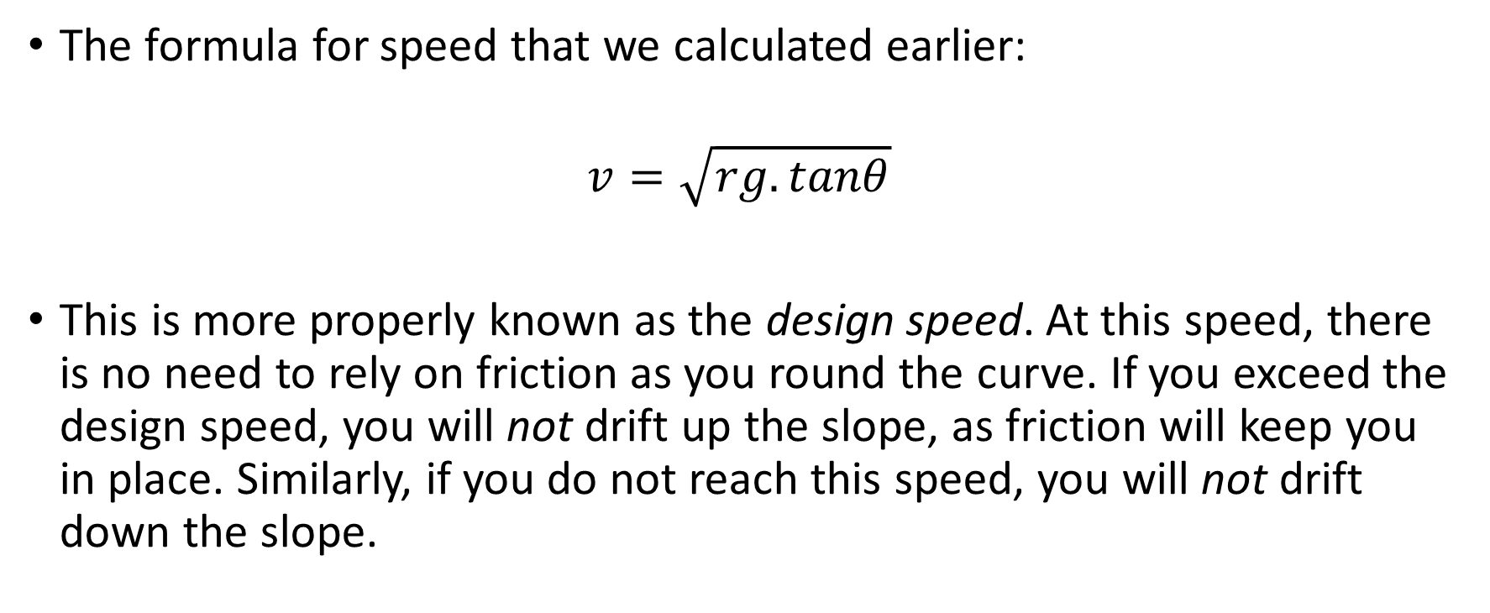
FORCES ON A BANKED TRACK
The formula for speed that we calculated earlier:
$$v=\sqrt{rg.tanθ}$$
This is more properly known as the design speed. At this speed, there is no need to rely on friction as you round the curve. If you exceed the design speed, you will not drift up the slope, as friction will keep you in place. Similarly, if you do not reach this speed, you will not drift down the slope.

Slide 6
EXAMPLE
A curved section of track on an Olympic velodrome has a radius of 50m and is banked at an angle of 42˚ to the horizontal. A cyclist of mass 75kg is riding on this section of track at the design speed.
Calculate the net force (i.e. the centripetal force) acting on the cyclist.
Calculate the design speed of this section of the track.
Notes:
a. 662 N. b. 21 m/s.

Slide 7
BANKED CURVES WITH FRICTION
Sometimes it is necessary to rely upon friction to travel either faster or slower than the design speed. In these circumstances, friction must be included in the vector calculations:

Slide 8
BANKED CURVES WITH FRICTION
For example, suppose that we had to rely upon friction to prevent us from drifting up the slope. The friction force would be directed down the slope, to provide additional centripetal force.
Believe it or not, it is possible to solve for the centripetal force here, by calculating the horizontal components of the normal and frictional forces…
F_{N}
F_{F}
F_{C}
F_{N}
F_{g}
θ
F_{C}
F_{F}
However, this will be left as an exercise for you to attempt later ;)
θ
F_{g}
Notes:
Friction and Normal are perpendicular

Slide 9
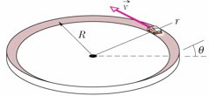
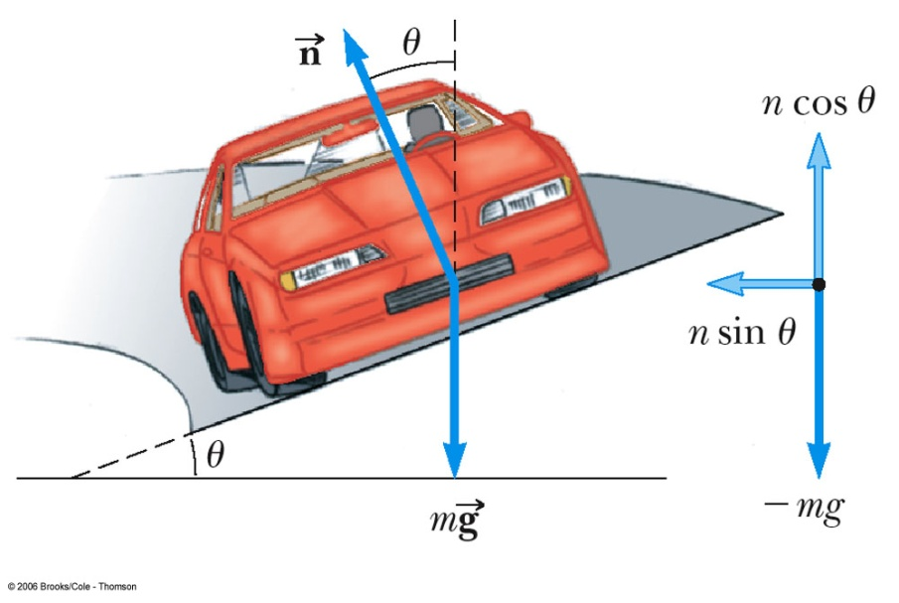
BANKED CURVES – EXAMPLE 2
A car moving at the designated speed can negotiate the curve. Such a ramp is usually banked, which means that the roadway is tilted toward the inside of the curve. Suppose the designated speed for the ramp is to be 13.4 m/s and the radius of the curve is 35.0 m. At what angle should the curve be banked?

Slide 10
BANKED CURVES – EXAMPLE 2

